Slide 1
LAPTOP SHOP USING SPRINGBOOT
Team Members
Vivek Khobragade - EBEON0722629139
Vishal Lokhande - EBEON0722634455
Vamsi Doma - EBEON0722633124
Mohammed Ali Pasha – EBEON0722114452
Jerome David – EBEON0722632534
Guided by
Varadharajan A

Slide 2
Laptop Shop using Spring Boot
The primary goal of e-commerce is to reach maximum customers at the right time to increase sales and profitability of the business. Functions of e-commerce include buying and selling goods, transmitting funds or data over the internet.

Slide 3
(MODULE-1)
Categories Of Laptops
This module presents different categories of laptops.

Slide 4
MODULE-2
Laptop Details
This Module presents different categories of laptop details

Slide 5
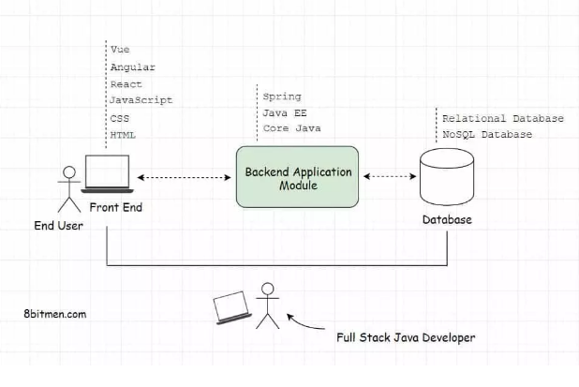
FULL STACK DEVELOPING

Slide 6
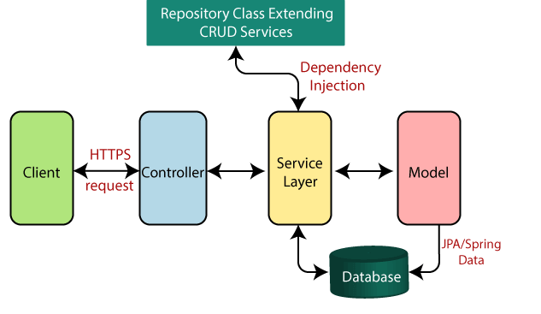
SPRING BOOT FLOW ARCHITECTURE

Slide 7
Dependencies:
➢ spring-boot-starter-security
➢ spring-boot-starter-Thymeleaf
➢ spring-boot-starter-web
➢ spring-boot-Devtools
➢ Mysql-connector-java
➢ spring-boot-starter-data-jpa

Slide 8
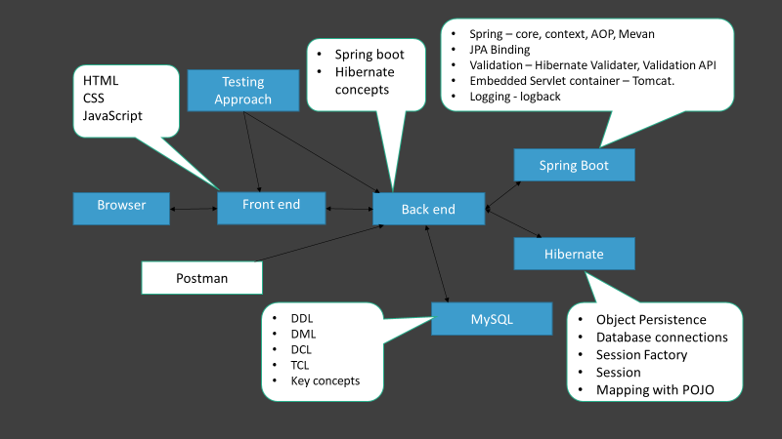
Project overview
Project Architecture
Approved
Customer
Pending
Login
Dashboard
Stock maintenance
Report
Order
checkout

Slide 9
Spring – core, context, AOP, Mevan
JPA Binding
Validation – Hibernate Validater, Validation API
Embedded Servlet container – Tomcat.
Logging - logback
Spring boot
Hibernate concepts
HTML
CSS
JavaScript
Testing Approach
Spring Boot
Browser
Front end
Back end
Hibernate
Postman
DDL
DML
DCL
TCL
Key concepts
MySQL
Object Persistence
Database connections
Session Factory
Session
Mapping with POJO

Slide 10


Dataflow diagram
Admin
Add product to cart
Change/Update categories
Shopping Cart
Add product to cart
Cart Items
Browse
customer
Quantity
View/edit cart
Item Details
Checkout
Item Details

Slide 11
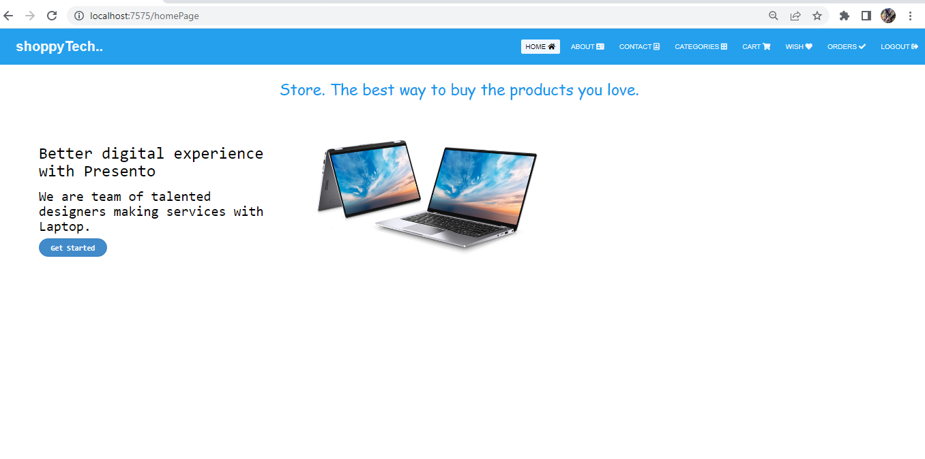
HOME PAGE

Slide 12
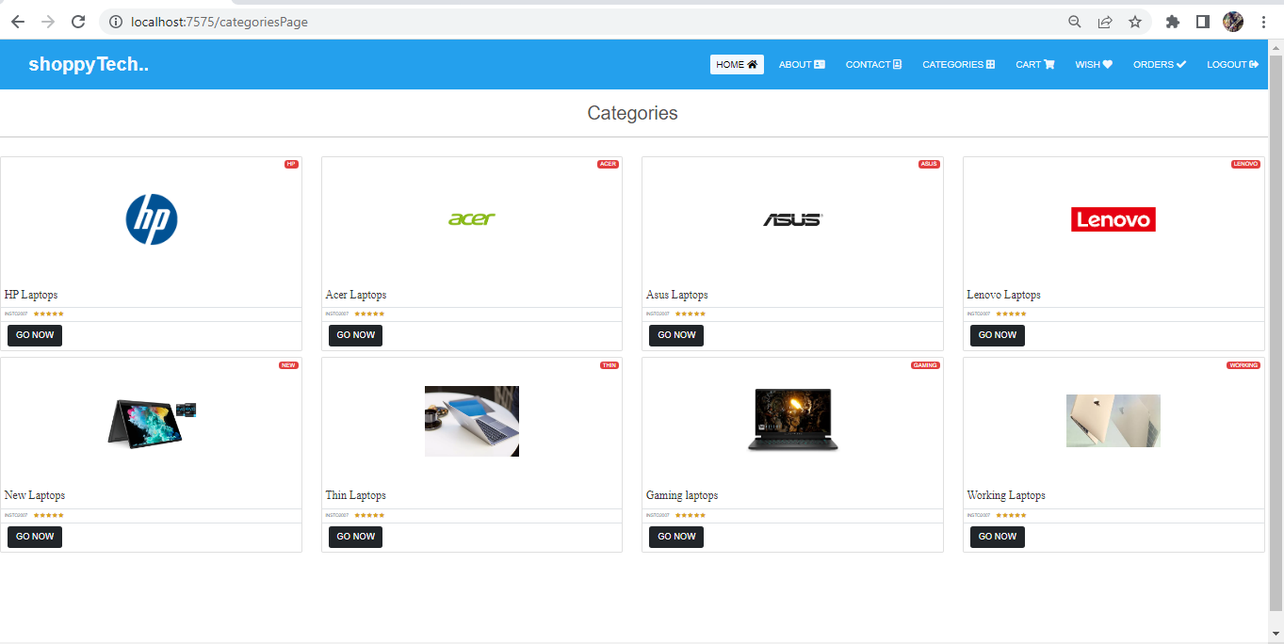
CATEGORIES PAGE

Slide 13
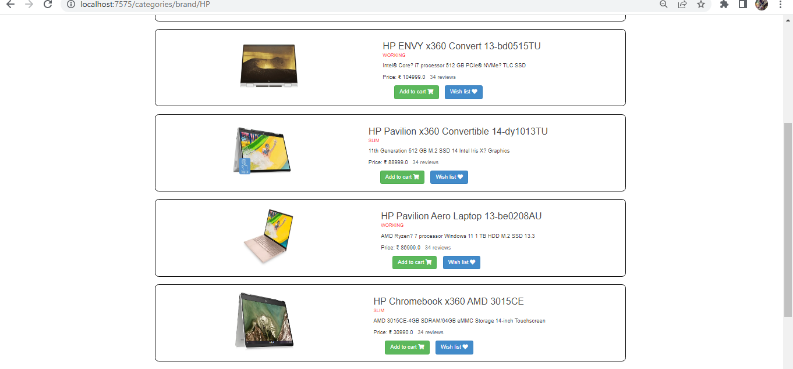
HP LAPTOP

Slide 14
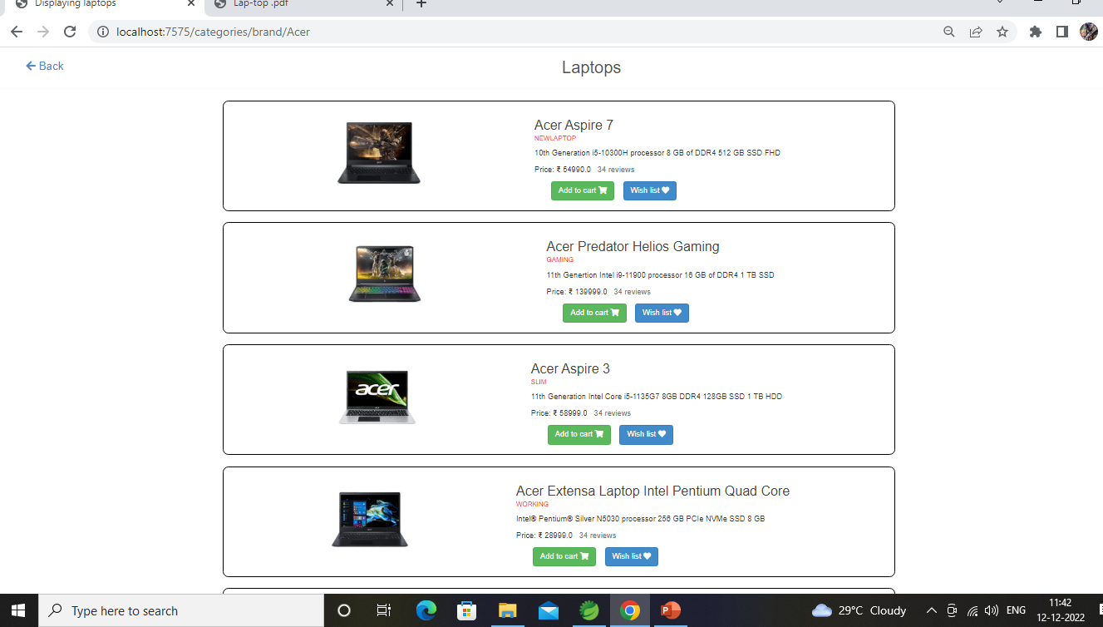
ACER LAPTOP

Slide 15
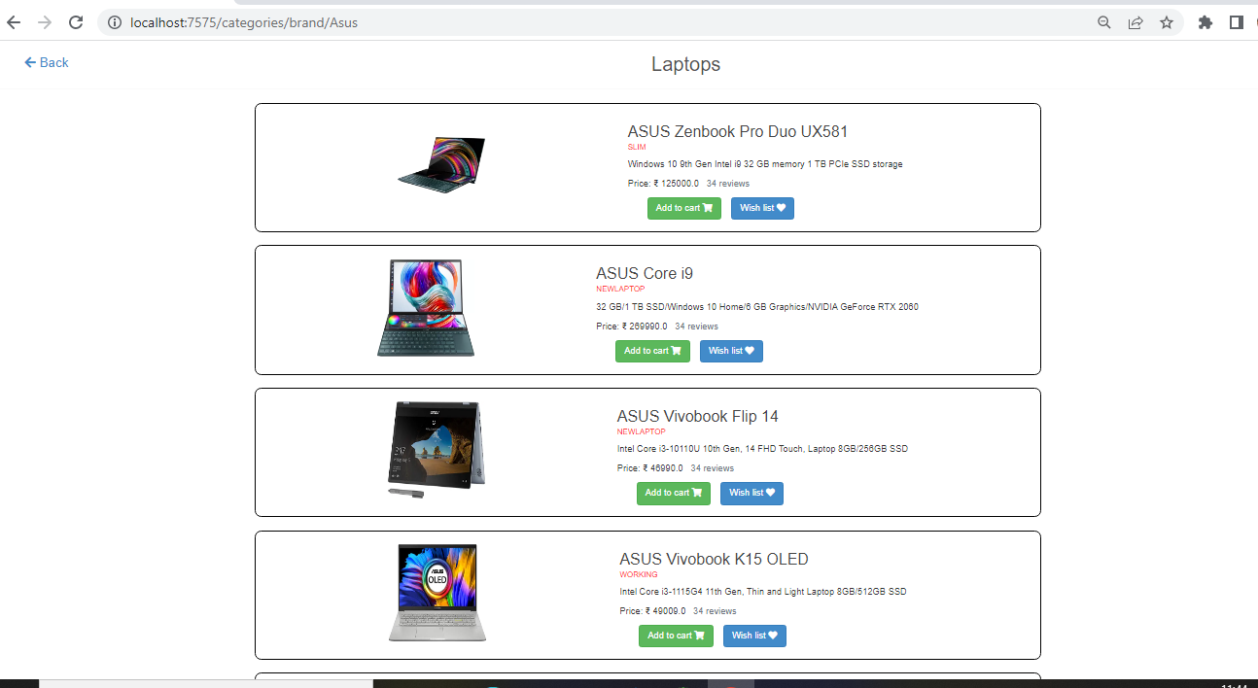
ASUS LAPT0P

Slide 16
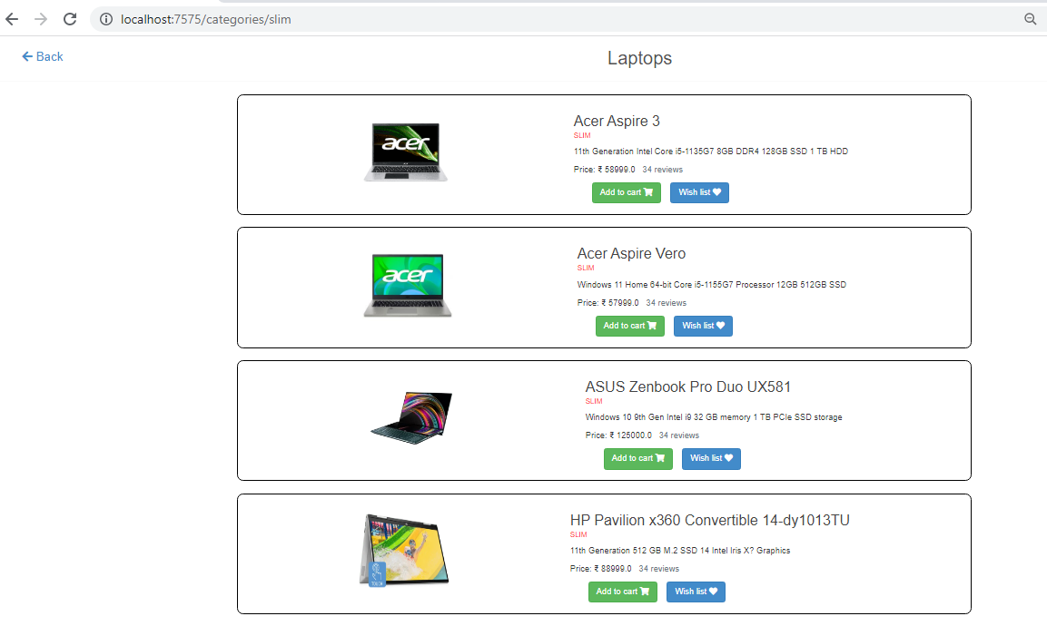
THIN LAPTOP

Slide 17
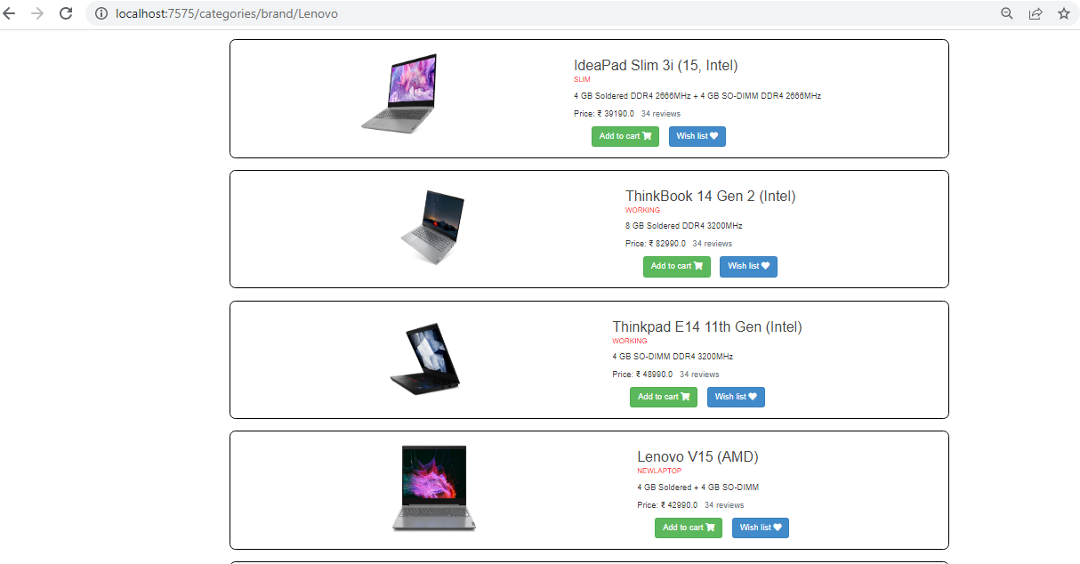
LENOVO LAPTOP

Slide 18
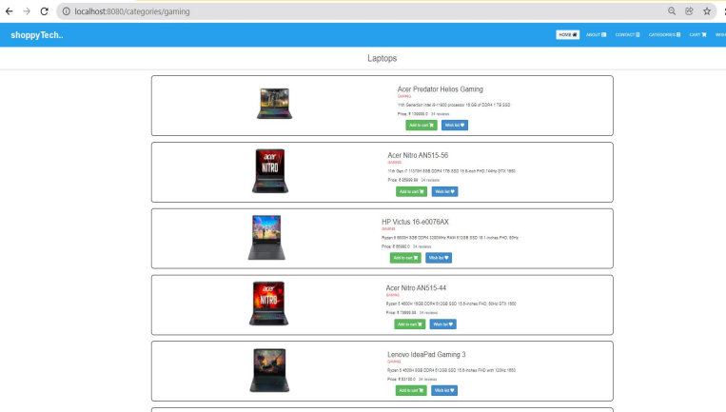
GAMING LAPTOP

Slide 19

Challenging issues
,
Changing Server port=7575
Enabling Debugging

Slide 20
Features about the module
Extensive Product Information
User friendly design

Slide 21
Future enhancement
The scope of shopping websites in India bloomed during the pandemic. This success can also be the result of increased internet use among our generation.
You can deploy Spring Boot applications to a variety of cloud platforms like heruko,kubernetics,AWS (Amazon web services).

Slide 22
Conclusion
Laptop shop project explains about the E-commerce Shopping, This project mainly explains the various actions related to online shopping. Like displaying laptop products depends on brands, styles then add the favourites to wishlist for buying those products add them in cart select the product which you want to buy and remove the product which you don’t want to buy.

Slide 23


